Slide 1
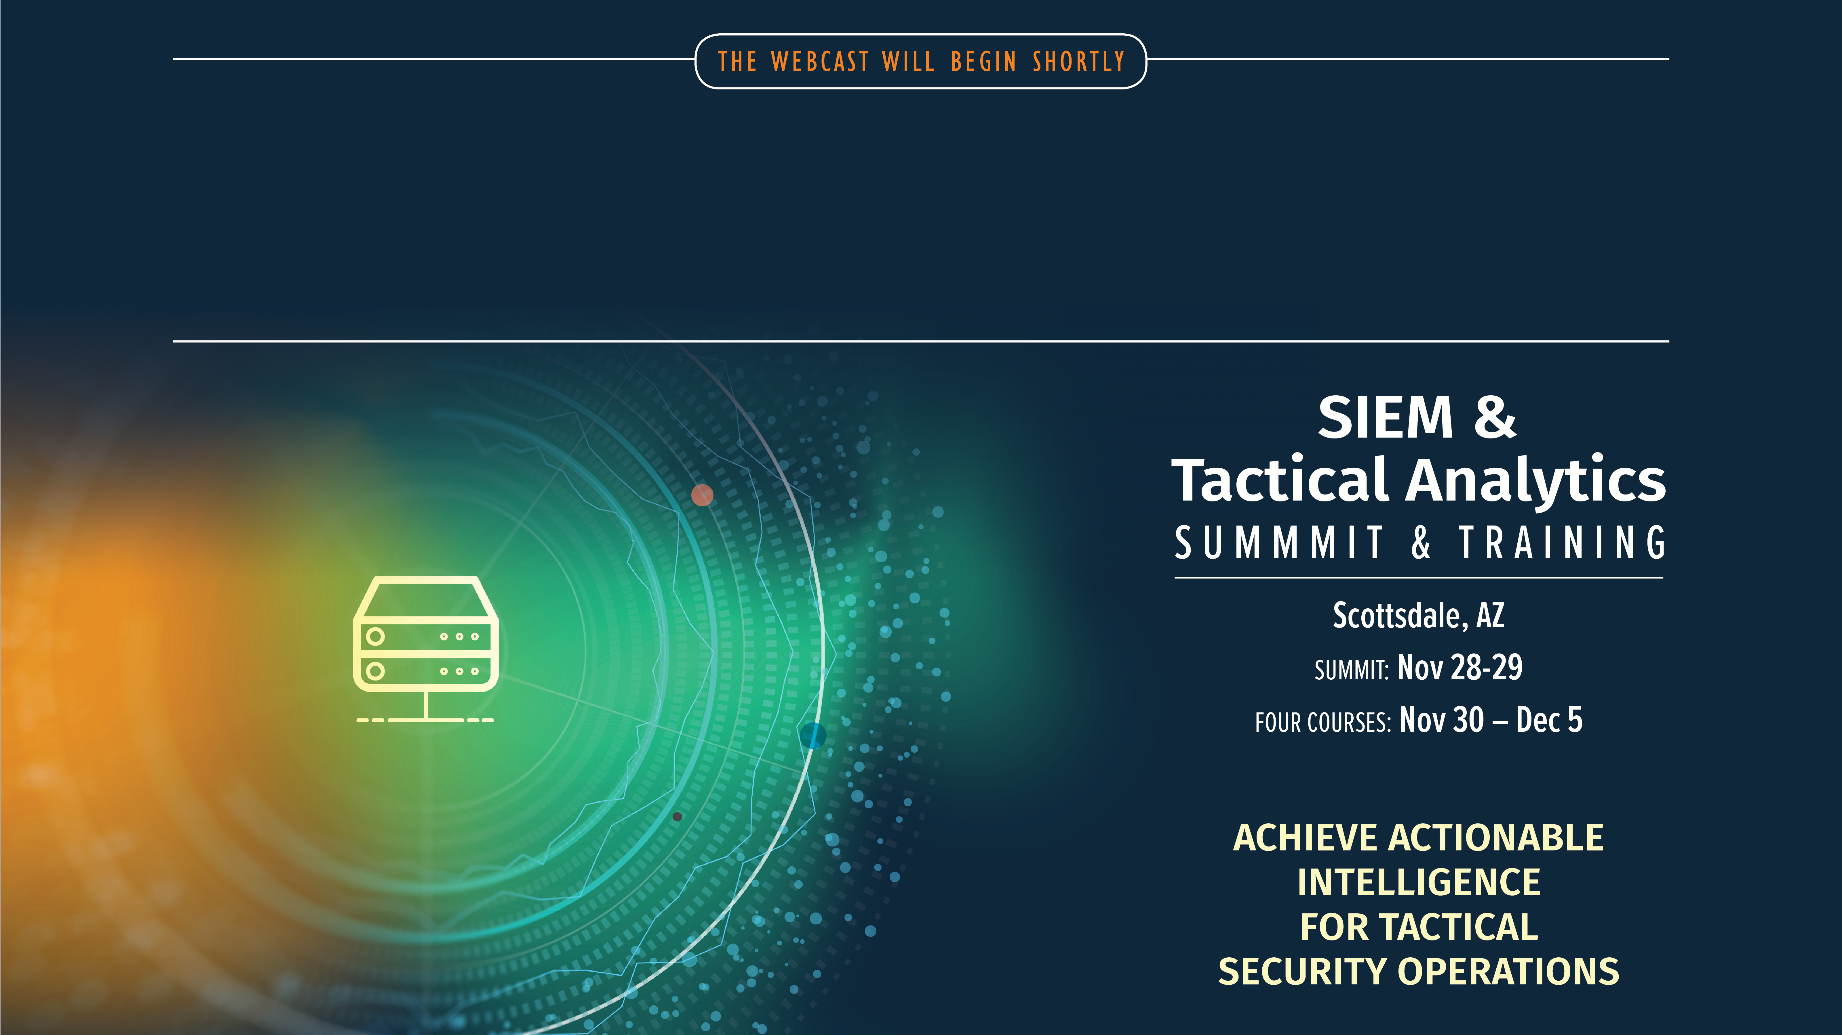

Slide 2
SEC555
Presentation based on SEC555: SIEM with Tactical Analytics
EDR vs SIEM - Place your best! The fight is on
Justin Henderson (GSE # 108)
@SecurityMapper

Slide 3

About Me
Author of SEC555: SIEM with Tactical Analytics
GIAC GSE # 108, Cyber Guardian Blue and Red
58 industry certifications (need to get a new hobby)
Two time NetWars Core tournament winner (offense)
And security hobbyist and community supporter
Collecting interns/contributors in bulk (research teams)
Release research to the community
See https://github.com/SMAPPER

Slide 4
Welcome!
A copy of this talk is available at: https://github.com/SMAPPER/presentations
More free stuff: https://github.com/HASecuritySolutions Disclaimer:
This talk represents my personal views not SANS. I do not get money, favors, or items from any EDR or SIEM vendor

Slide 5

What is EDR?
So what is Endpoint Detection and Response (EDR)
Use to be ETDR (Endpoint Threat Detection and Response)
Focus is on ENDPOINTS!!! <--- Yay!
Capable of real-time detection
Capable of real-time prevention
Tend to be a one-stop shop for solution
Likely to require an agent (agentless in the works)

Slide 6
So what really is EDR?
Depends on the vendor or open source solution
EDR is the “spirit of providing strong detection and prevention capabilities on endpoints with endpoint data”
Vendors achieve this with:
Performing automated analysis at the endpoint
Machine learning (supervised or unsupervised)
Integrating threat intelligence, feeds, and IOCs
Supporting real-time endpoint queries
NG AV functionality + reporting

Slide 7
EDR Solutions
Commercial
Open Source – Detection focused
Carbon Black
CounterTack
CrowdStrike
Cybereason
FireEye
Tanium
RSA
And more…
Google Rapid Response
Mozilla InvestiGator
El Jefe
Lima Charlie
OSQuery
Kind of:
Sysmon
Commercial solutions are stronger

Slide 8

What is SIEM?
SIEM = Security Information and Event Management
Many other acronyms LCE, SEM, SIM
Focus is on LOGS / data
Heavy emphasis on detection
Near real-time
Capable of full network and endpoint visibility
Requires multiple moving parts
May or may not require an agent

Slide 9
SIEM Solutions
Commercial
Open Source
Splunk
Elastic Stack
LogRhythm
HP ArcSight Enterperise Security Manager (ESM)
IBM QRadar
RSA Security Analytics
And more…
Elastic Stack
Graylog
OSSIM
Prelude
Syslog-NG
Windows Event Collector

Slide 10
Market Share
EDR is growing rapidly
$238 million in sales (2015) vs ~$500 million (2016)¹
Estimated compound annual growth rate of 25%²
Estimated $2.6 billion dollar growth from 2016 to 2021²
SIEM is already massive
Estimated compound annual growth rate of 12%³
Estimated $5.9 billion dollar market size in 2021³
[1] https://blogs.gartner.com/avivah-litan/2017/01/12/booming-500-million-edr-market-faces-stiff-challenges/ [2] http://www.businesswire.com/news/home/20170628006250/en/Endpoint-Detection-Response-Market---Drivers-Forecasts [3] https://solutionsreview.com/security-information-event-management/siem-market-growth-technavio/

Slide 11
What are we talking about?
EDR - "the apple"
SIEM - "the banana"
Endpoint solution
Agent based
Endpoint data sources
Encryption not an issue
Designed for endpoint prevention and analysis
Native prevention capabilities
Strong endpoint detection
Multiple data sources/parts
Likely has agents
Unlimited data sources
Encryption may be issue
Pure play analysis / compliance
Capable but typically not used for prevention
Massive detection capabilities

Slide 12
The Problem
Organizations are replacing SIEM with EDR
Some MSSPs are as well
These solutions are different
They are complimentary to each other
They are not replacements for each other
We as either consumers or security practitioners, need to be aware of this
Managed detection and response (MDR) != Managed SIEM

Slide 13





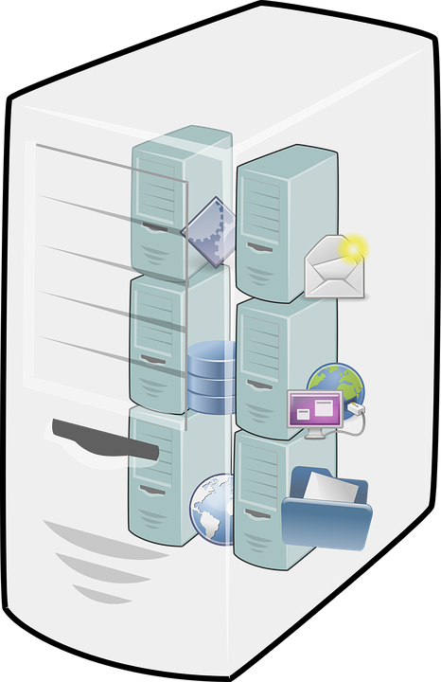





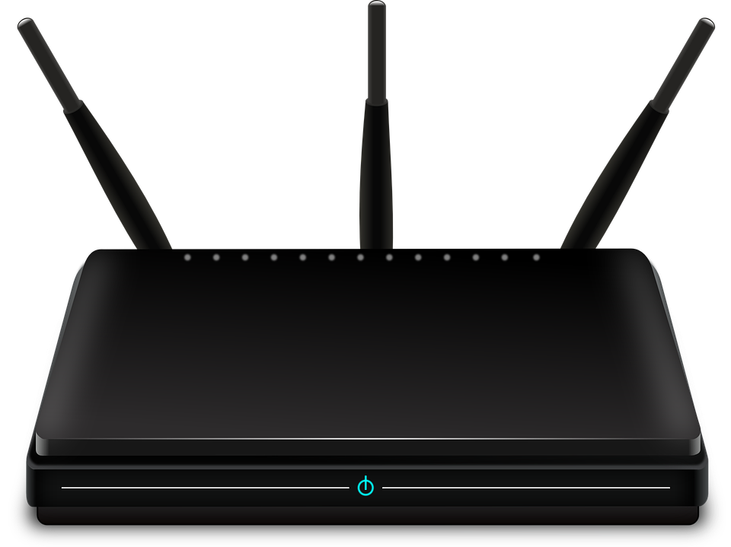



Advantages of SIEM
Total visibility
Simple to correlate between disparate data sources
Context, enrichment capabilities, searching and more
Handle vast amounts of data
Yes… big data but if I call it big data I might throw up

Slide 14

Disadvantages of SIEM
Out of the box situation is horrendous
Default use cases/alerts/pre-built searches can be awful
No logs… no data… nothing
Other concerns:
Compliance requirements
High upkeep and maintenance
Log collection (is total visibility required or necessary?)
Staff availability / Training <- most overlooked problem

Slide 15

Advantages of EDR
Default setup provides decent prevention capabilities
And has centralized endpoint reporting capabilities
Has pre-built dashboards and workflows
Design allows for modularity
Focus can be on strong prevention with detection
Focus can be on no prevention and 100% detection

Slide 16
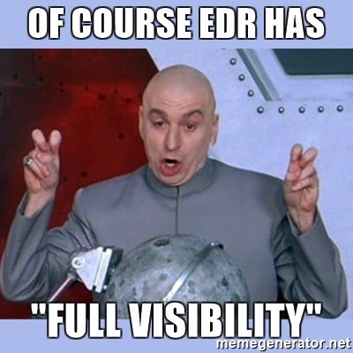
Disadvantages of EDR
Requires 100% asset awareness and proper configuration
Required for EDR to do anything
Other concerns:
Blind to all non-endpoint data
EDR to EDR varies dramatically
High upkeep and maintenance
Depending on solution may be a black box
Staff availability / Training <- most overlooked problem

Slide 17

Similar Failures
Both EDR and SIEM tend to fail from the same issues
No autopilot
No knowledge of your organization
Typically caused by:
Overestimating abilities
Underestimating staffing needs
Training
Time

Slide 18
Maturity
EDR and SIEM require organizational maturity
Security basics should be required before these products
SIEM requires proper data sources (firewall, Windows, etc)
And the best detection comes from simple concepts
Like principle of least privilege
EDR requires full system deployment and management
And understanding of those systems
Domain and organizational expertise MUST BE factored into managed services

Slide 19
Which is better?
A well designed SIEM should outperform EDR in detection
By a long shot
Simpler to slice and dice multiple data sources
More context and supports log enrichment
A well designed EDR should outperform SIEM in prevention
Simpler to "react" to events

Slide 20
So which one do you need?
Yes
Apple and Banana both are good for you
But depending on your health you may need one over the other (vitamins + minerals)
Put plainly you need meat and vegetables more than fruit
So why are we having this conversation?

Slide 21
Both Require People, Trained People
Gartner’s response on EDR (Anton Chuvakin)¹
“… there are more skilled network security analysts than … endpoint security analysts”
“’focus on the endpoint’ may be a trend, but it does not mean it is operationally feasible for a lot of companies.”
Gartner’s response on SIEM (Anton Chuvakin)²
“Your investment in SIEM will be completely, totally, absolutely wasted if you don’t have smart people operating the tool on an ongoing basis”
[1] https://blogs.gartner.com/anton-chuvakin/2015/07/23/reality-check-on-edr-etdr/
[2] https://blogs.gartner.com/anton-chuvakin/2012/08/09/on-people-running-siem/

Slide 22
Use Cases
SIEM
EDR
Organization wishing to have full visibility
Strategic detection
Enrich logs
In-house driven analysis
Compliance requirements
Accept many data sources
Focus on endpoint protection
Targeted detection
Automatic vendor driven analysis
Custom tuned prevention
Ability to query endpoint data quickly

Slide 23
Summary
EDR and SIEM = Awesome but not the same
But both require staff training, tuning, and maintenance
Both would be ideal
Choose your battle
Live within your budget
Plan to invest significant time
EDR or SIEM without staff investment = FAIL

Slide 24


